Slide 1
DigiAero
Digitizing your airport Experience

Slide 2
TEAM MEMBERS
THEME
Gagandeep Bhatia
Vatsal Tulshyan
Airport

Slide 3
Video Demonstration URL
Code Repository URL
https://youtu.be/gfvi_Y5gax0
Mobile App ->
https://github.com/bhatiagagan24/Jack-The-Hack-Hackathon-
APIs-> https://github.com/bhatiagagan24/Jack-The-Hack-Hackathon-/tree/landing_page_photo_dashboard/landing_page_dashboard/back_end

Slide 4
Problem Statement
Imagine a world where users can access every airport service right from their Phone? Imagine the satisfaction that the flyers will get from this service? Imagine the business it will generate for the outlets on the airport? Seems too cool right?
The current problems that the flyers face right now, is that there is no unified source of information about the activities on a airport. Requesting a service has also been a tedious task on an airport. Further, there is no lack of activities and consumer shops on the airport, yet flyers prefer to seat themselves at a single spot before a flight, which further hurts the business interests of the shop owners.

Slide 5
Solution
The service that we have designed to address the issues mentioned in the previous slide consists of a Cross-Platform Mobile Application and a set of APIs.
The Mobile App is well connected with the APIs and allows the flyer to stay up-to-date with all kind of deals, gain insights into the delicacies being offered in the lounge and also request services like Wheelchair assistance.
The APIs can also easily be used by the authorities to deliver the latest information to the flyers and also by airport outlets to deliver their latest deals to the flyers.
‘

Slide 6
Technologies utilized
Programming Languages - Python and Dart
Framework for Mobile App - Flutter (Dart)
Framework for Web APIs - Flask (Python)
Database - SQLite
Google Sign In - GCP OAuth Service

Slide 7
Making our app scalable and complete
The services which we have designed and developed (Mobile App and APIs) can easily be made more scalable.
By our analysis: -
SQLite can easily be replaced with MySQL, which can further support more Concurrent Connections and heavy read writes.
A suitable encryption algorithm will have to be implemented for storing sensitive informations like Card Details and so on. These are not being encrypted right now in the prototype.
More Sign-In options including Mobile OTP signin can be added to make the app more accessible.
Lounge Eligibility check algorithm will have to be implemented by the authorities and update it on the GET request route.

Slide 8
Screenshots

Slide 9
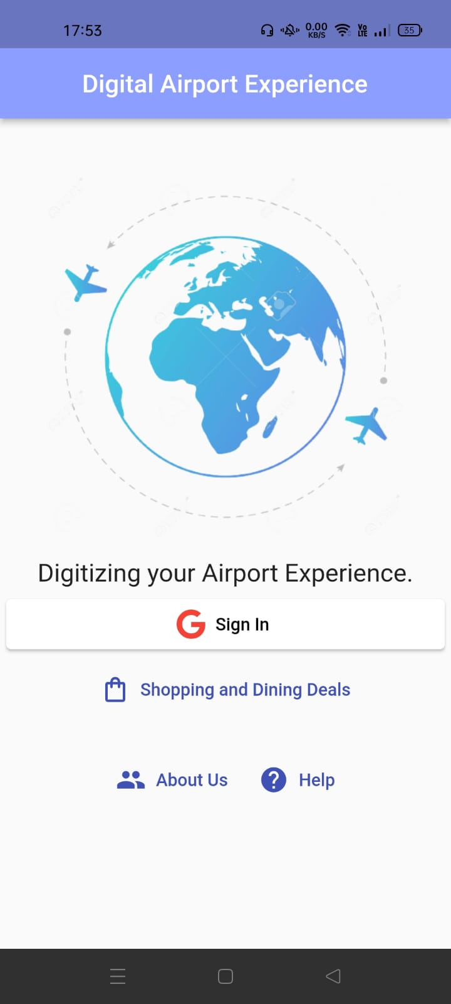
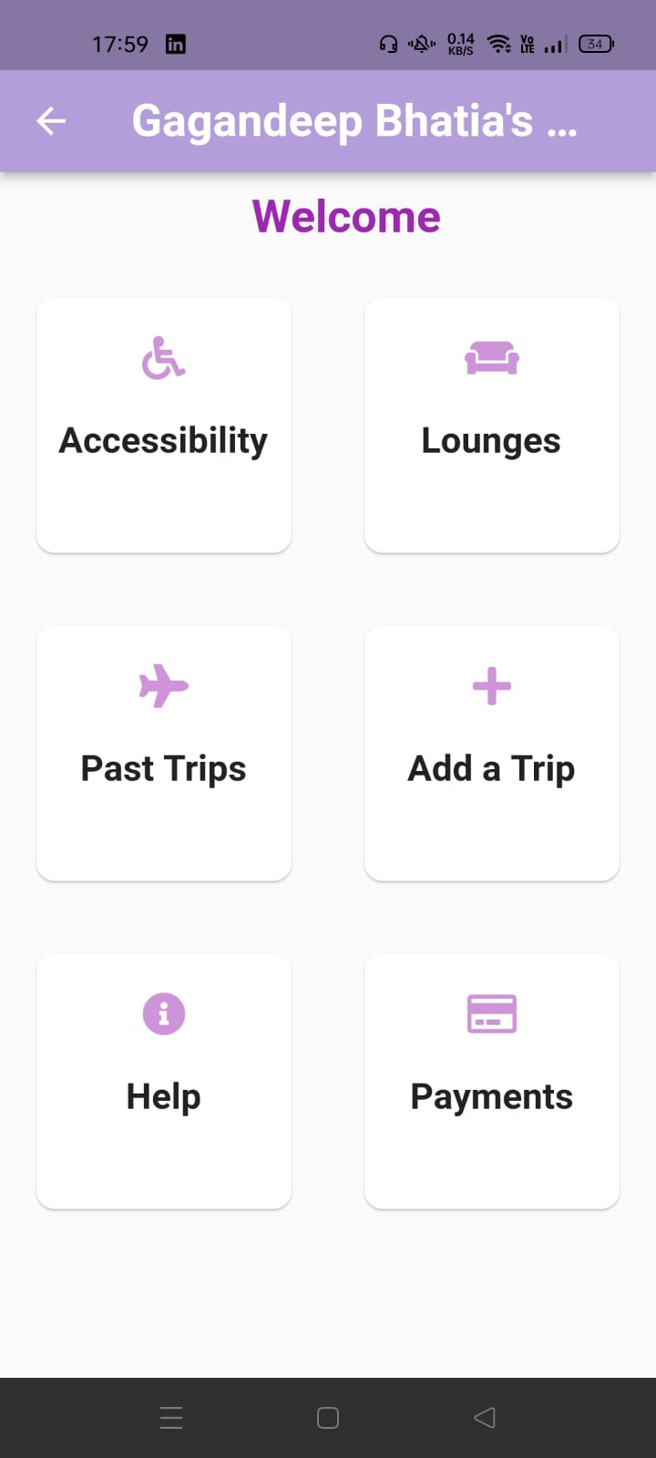
App Landing Page
After Sign-In

Slide 10
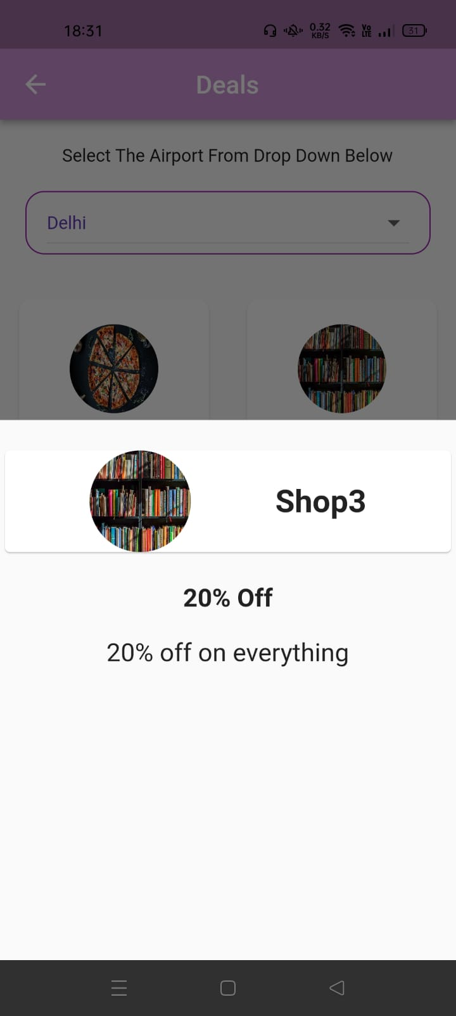
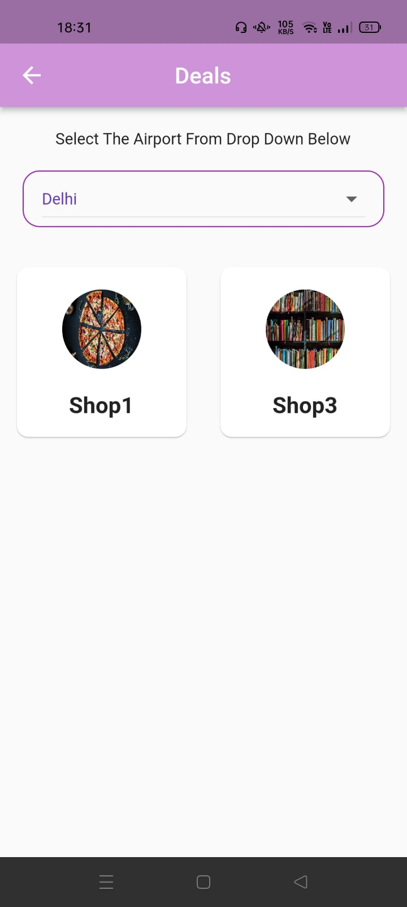
Check out a Deal
Deals at an airport

Slide 11
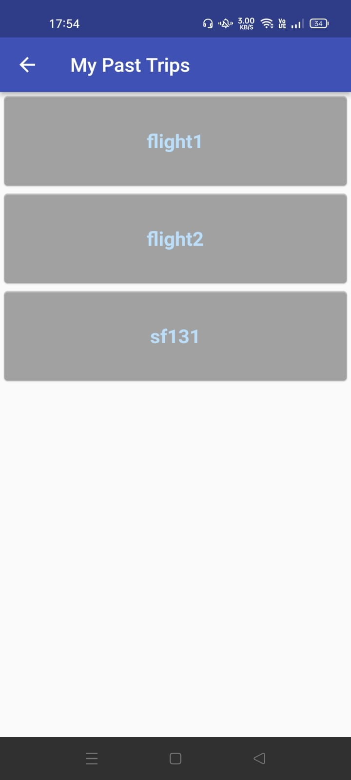
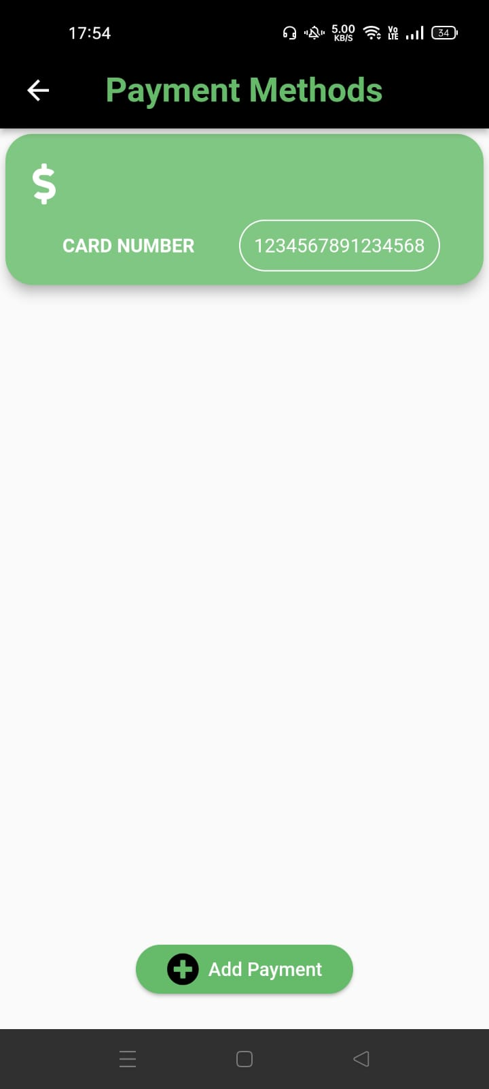
Past Trips
Upload Card Info

Slide 12
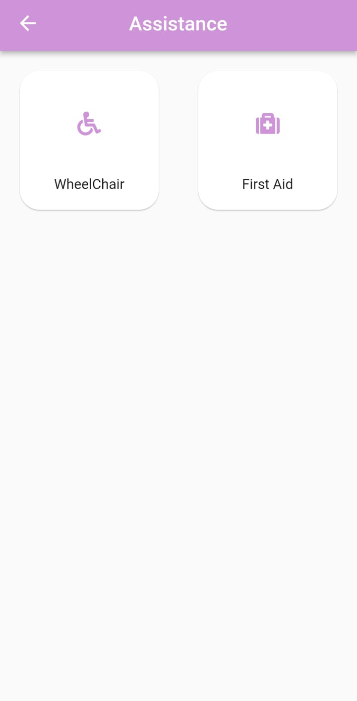
Ask for Assistance

Slide 13
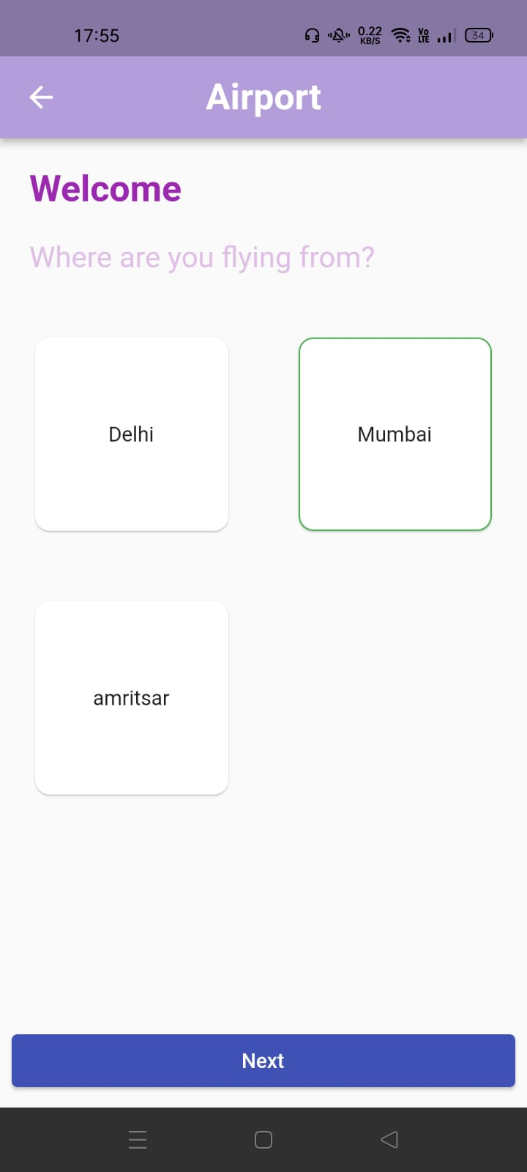
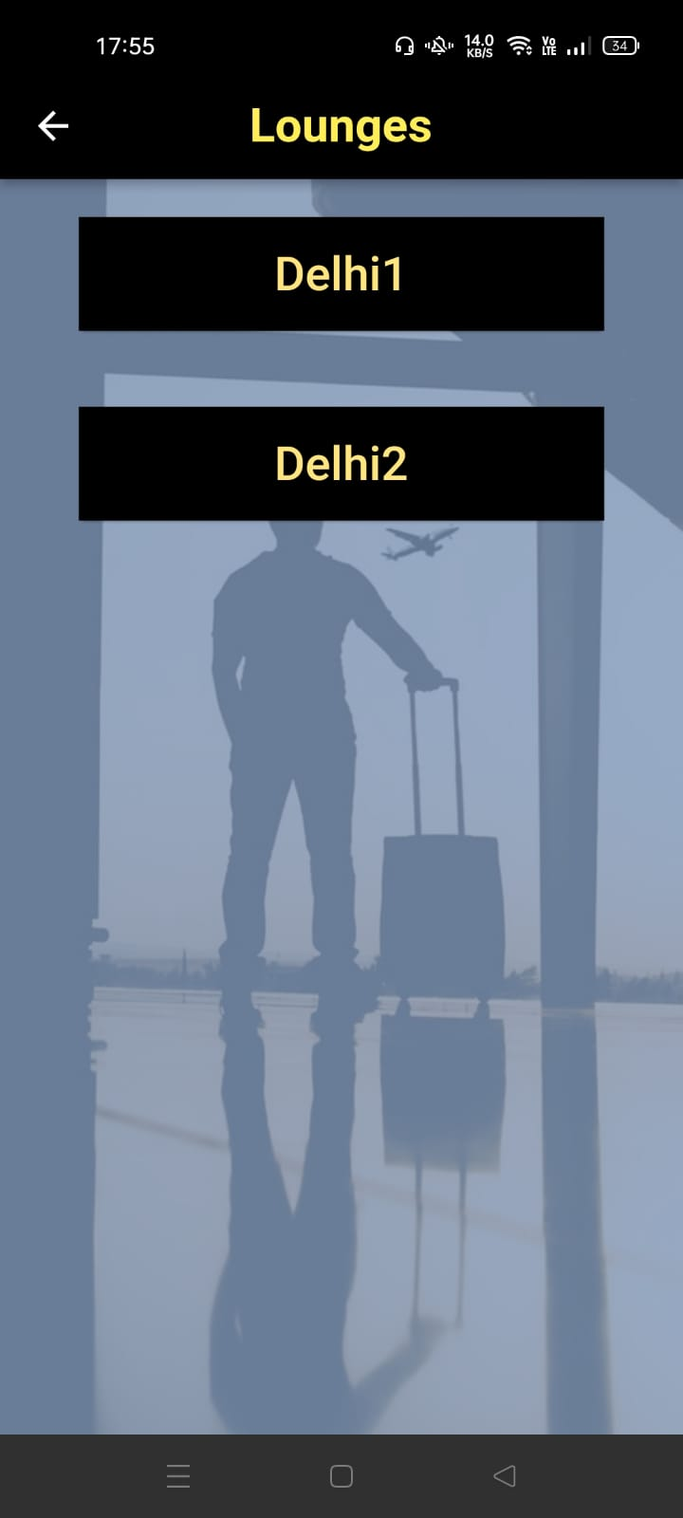
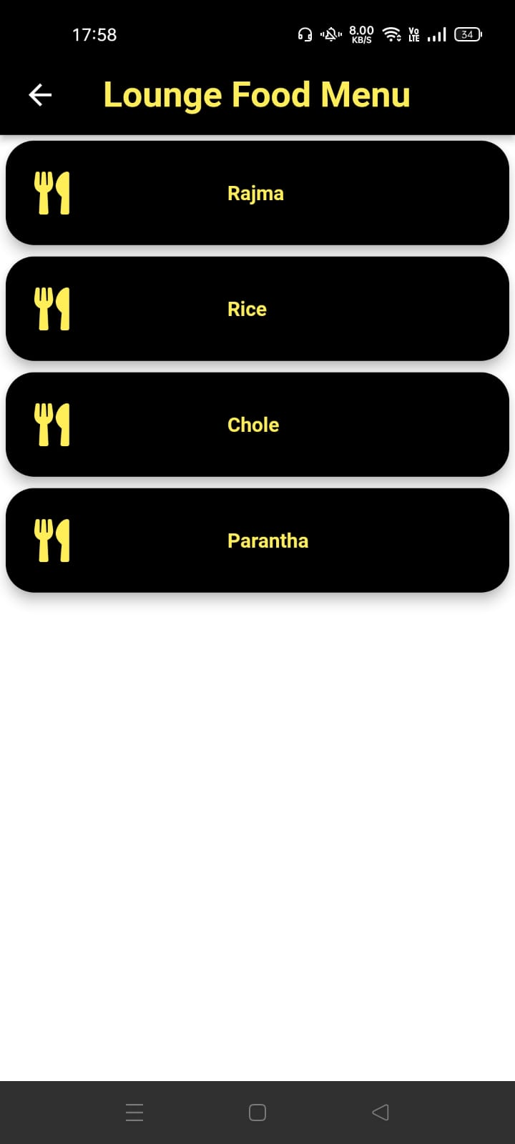
Select an Airport
Select the Lounge
Check out the delicacies

Slide 14
Thank You for Checking out the Project.
We hope you liked our Submission !

